Slide 1
Security Council
Chairs: Claire Toh, Henri Reyes, Jasper Yeh

Slide 2
Situation in Yemen

Slide 3
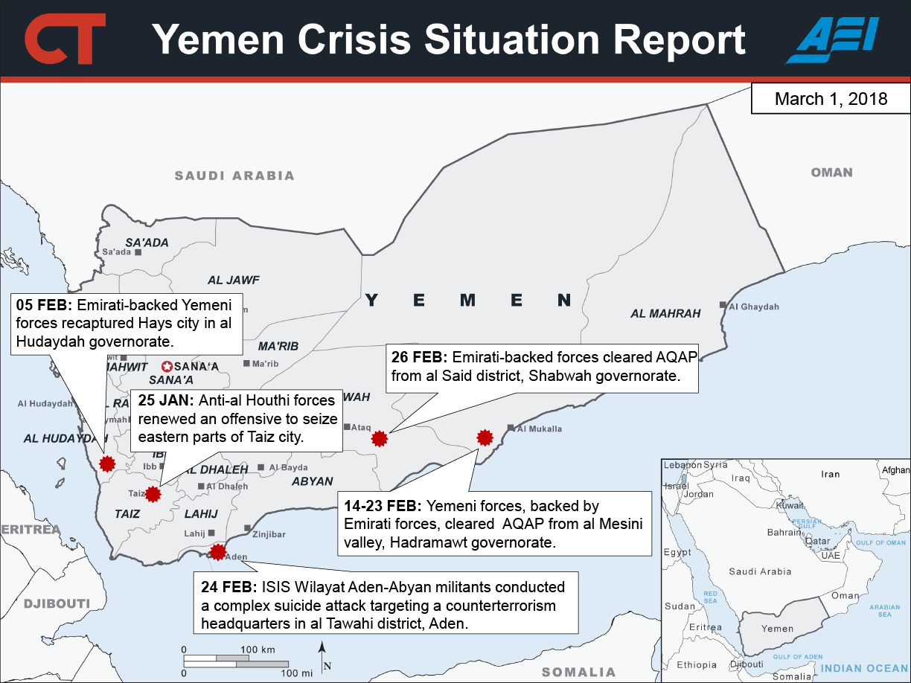
Source: https://www.criticalthreats.org/briefs/yemen-situation-report/2018-yemen-crisis-situation-report-march-1

Slide 4
The role of the United Arab Emirates
29 Jan 2018
Yemen’s southern coastal city of Aden has been gripped by fighting after armed separatist forces that is backed by the UAE
16 March 2018
The UAE and Saudi Arabia disagree at the UNHRC
Three years ago, both against Houthis--now split
SA for Yemeni Congregation for Reform, branch of Muslim Brotherhood
UAE against cooperation with the organization
https://www.middleeastmonitor.com/20180316-uae-saudi-disagreement-in-geneva-puts-yemens-unity-at-risk/

Slide 5
Saudi-Houthis talks to end Yemen war
16 Mar 2018
Clandestine discussion have been going on for two months in Oman
Warring parties discussed ways to halt the conflict
Currently 22M Yemenis in need of humanitarian assistance
Resolution of the conflict needs to begin with a truce
https://www.aljazeera.com/news/2018/03/saudi-secret-talks-houthis-yemen-war-report-180315192056518.html

Slide 6
Situation in the CAR

Slide 7
Gabon to Quit Peacekeeping Force in CAR
March 9, 2018
Negotiations underway to withdraw forces
Gabon has 444 out of 12,500 troops in MINUSCA
One of nine countries whose MINUSCA forces accused of sexual offense
Withdrawal of forces may lead to resurgence or continued violence
“Gabon to Quit UN Peacekeeping Force in Central African Republic.” Punch Newspapers, Agence France-Presse, 9 Mar. 2018, punchng.com/gabon-to-quit-un-peacekeeping-force-in-central-african-republic/.

Slide 8
Summary of UNHCR spokesperson’s words Babar Baloch at press briefing at Palais des Nations in Geneva
March 16, 2018
UNHCR office in Chad in need of USD$149 million
Only 2% of funding met
Fighting since December 2017 has caused 92,180 people to flee to Chad
Chad town of Gore providing shelter for over 88,000 refugees
One of the most underdeveloped and poor regions of Chad
16,520 refugees still in villages near the insecure border
Chad continues to play extremely important role housing refugees
United Nations. “Chad: Funding Shortfall Threatens Central African Refugees.” UNHCR, UNHCR 2001-2018, 16 Mar. 2018, www.unhcr.org/news/briefing/2018/3/5aab91664/chad-funding-shortfall-threatens-central-african-refugees.html#.

Slide 9
Joint visit of AU and EU ambassadors to Central African Republic
March 16, 2018
Peace and Security Council of European Union (EUPSC) met with the Peace and Security Council of the African Union (AUPSC)
Force commander of MINUSCA, cabinet of ministers of CAR, and National Assembly were also present
Discussed the agenda of sustainable stabilization of the CAR
EU nations have intervened considerably in CAR conflict
Battu, Virginie. “African Union - European Union Relations: Joint Visit of AU and EU Ambassadors to Central African Republic.” Council of the European Union, European Union, 16 Mar. 2018, 12:30, www.consilium.europa.eu/en/press/press-releases/2018/03/16/african-union-european-union-relations-joint-visit-of-au-and-eu-ambassadors-to-central-african-republic/.

Slide 10
Important Alliances
European Nations
EU contributed lots of peacekeeping forces and organized military interventions, namely the immense contributions of France
Surrounding member states of the Central African Republic
Neighboring nations housing most if not all refugees, namely Cameroon and Chad
Germany, Japan, EU, and USA
Significant donors and developmental partners to the CAR

